Slide 1
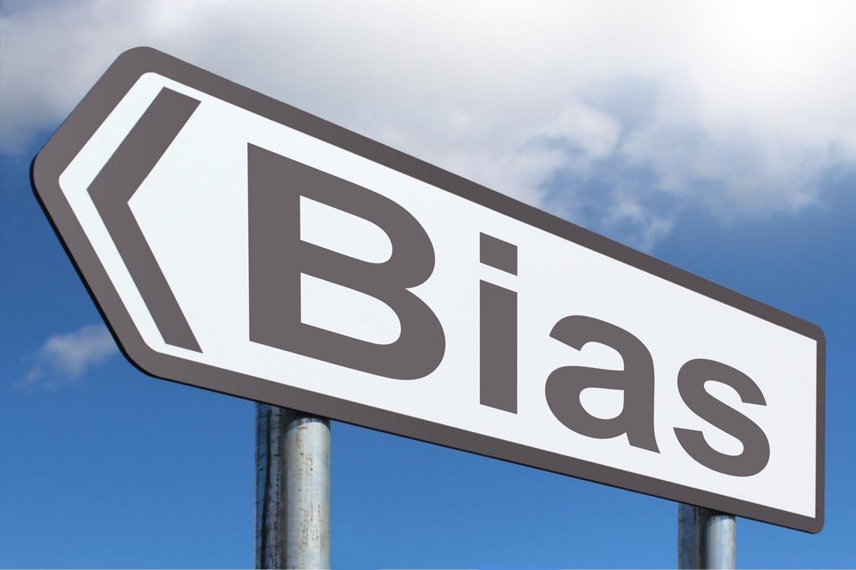
How do we avoid bias in machine learning algorithms?
Part 1

Slide 2


What is machine learning?
Subset of artificial intelligence
Makes predictions or decisions to create a particular output
Can create chain reactions based on new data, such as creating its own algorithms [1]
Various approaches available, deep learning now the dominant one

Slide 3

Overview of inherent bias
Inflexibility due to decisions made on initial data set
Machine learning in particular is likely to pick up on conscious/unconscious biases
For example, criminal risk assessment systems shown as biased against black people [2]

Slide 4
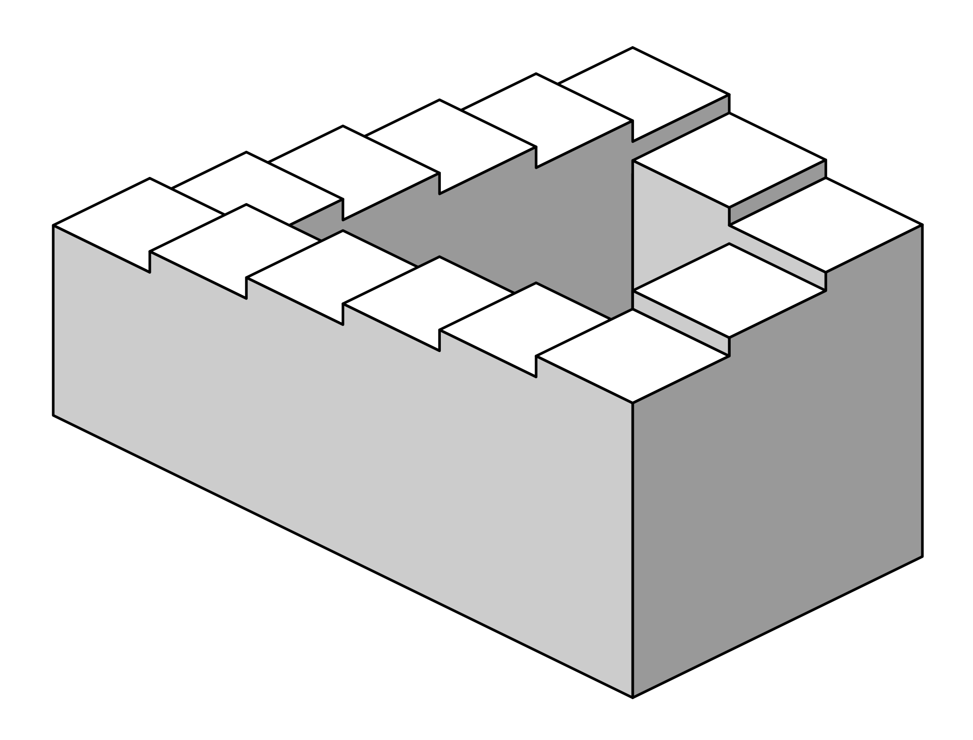
What are the barriers to resolution?
A company may have patented the algorithm, making it difficult to access
Machine learning algorithms can be difficult to analyse
Removing perceived biases from datasets can mean less accuracy, and may not guarantee fairness

Slide 5

Potential solutions
Improving algorithmic equity to identify and remove bias
Technical : creating methods and tools to find and counter bias in data
Monitoring : Gaining transparency, if needed shut down if not clear
Diversity : programmers mostly white and male, increase diversity?

Slide 6
Conclusion
Preparation is key; think of potential bias before you even introduce your dataset, what is missing, what may be exaggerated?
Make sure the dataset is as diverse as the group is representing as possible. You may have to weight data if not, however use caution if you are.
Test algorithms using real data. Know what you are testing for as well! Equality of opportunity is not the same as equality of outcome.

Slide 7

Any questions?/sources
[1] Ethem Alpaydin (2020). Introduction to Machine Learning (Fourth ed.). MIT. pp. xix, 1–3, 13–18. ISBN 978-0262043793.
[2] Angwin, Julia; Larson, Jeff; Mattu, Surya; Kirchner, Lauren (23 May 2016). "Machine Bias — ProPublica". ProPublica. Retrieved 18 November 2017.

